Slide 1

Mobile Authentication Process Modelling

Slide 2
Table of Contents
Process Map
Process Descriptions
Service Management
User Management
Credential Management
Role Management
Process Workflows
Service Management
User Management
Credential Management
Role Management
General remarks

Slide 3
Process Map

Slide 4
Process Map
Pair management
P1. Add user-device pair
P2. Remove pair
P2.1 (Website) remove device
P2.2 (App) remove user
P3. Change device name
Pair: User & Device, dus op de eGov website voeg je een Device toe en op de app voeg je een User toe.

Slide 5
Process Descriptions

Slide 6
Pair Management

Slide 7
Process P1: Add user-device pair
Log in & add device
Log in & add device
User logs in on the website using his eID and selects add device (with required name).
Installation & startup of app
User installs app on his device if it’s not yet installed & starts it up.
Scan QR code
User scans the QR code with his device or gives in his unique code on his device.
Verification
The webserver verifies if the codes match and will link user account (from on the website) to the communicating device.
Notification 1
The webserver notifies the user on the website that the device is linked to the user account (pair added) but that the device still needs to receive confirmation. (state signed)
Notification 2
The webserver notifies the user on the website that the device has received confirmation (state linked) and the procedure is successful. The device notifies the user that the procedure is successful.
Installation & startup of app
Scan QR code
Verification
Notification 1
Notification 2

Slide 8
Process P2.1: Remove pair: remove device (on website)
Log in & remove device
Log in & remove device
User logs in on the website using his eID and selects remove device.
Revoke certificate
The certificate authority (CA) revokes the certificate linked to the user-device pair.
Pair removal
The user-device pair is removed from the webserver and no longer in the list of devices.
Notification
The user is requested to remove the user from his device. (this is not possible in case the device has been lost or stolen but is also not necessary as the certificate is revoked in any case)
Revoke certificate
Pair removal
Notification

Slide 9
Process P2.2: Remove pair: remove user (on app)
Start up app & remove user
Start up app & remove user
User starts up the app and selects remove user.
Device update
After verification that the webserver has received the removal request, the user & it’s corresponding certificate is removed from the device.
Revoke certificate
The certificate authority (CA) revokes the certificate linked to the user-device pair.
Pair removal
The user-device pair is removed from the webserver and no longer in the list of devices.
Device update
Revoke certificate
Pair removal

Slide 10
Process P3: Change device name
Log in & edit name
Log in & edit name
User logs in on the website using his eID and clicks on the name the user wants to change.
Enter new name
The user provides the new name.
Update pair
The device’s name is changed & the updated pair is saved.
Notification
The user receives a notification on the website of the successful update.
Enter new name
Update pair
Notification

Slide 11
Process Workflows

Slide 12
Pair Management

Slide 13
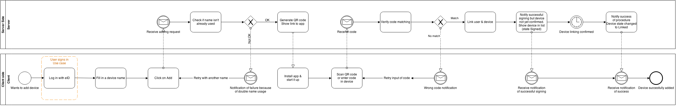
Process P1: Add user-device pair (level 1)

Slide 14
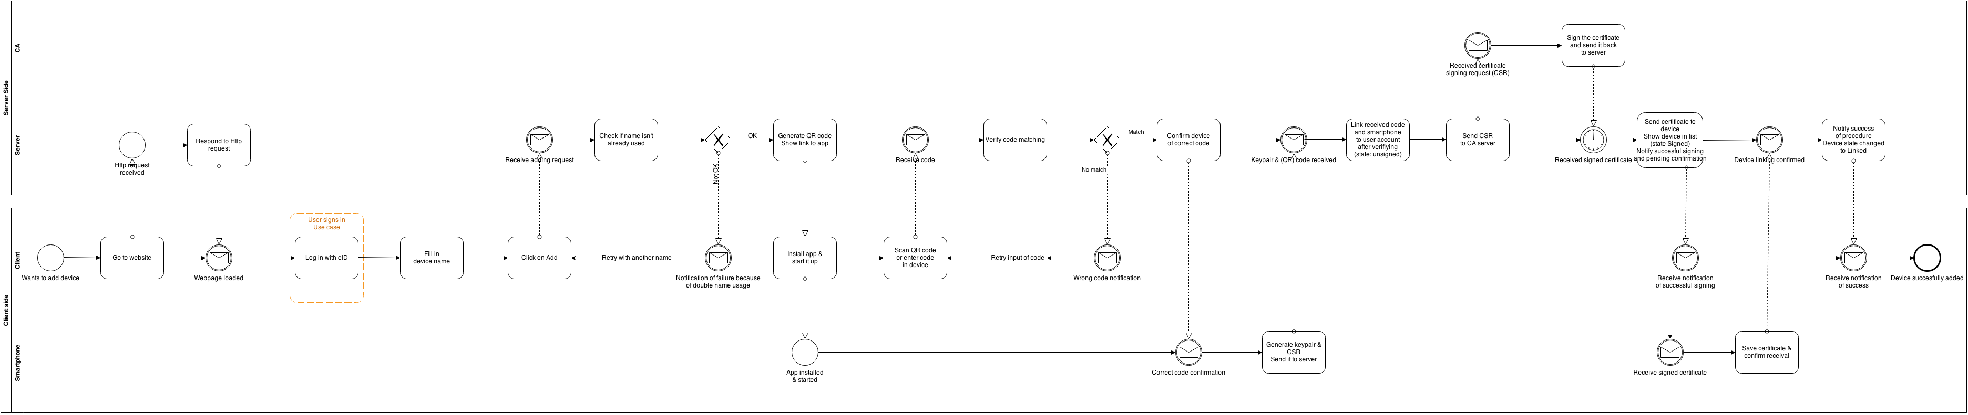
Process P1: Add user-device pair (level 2)

Slide 15
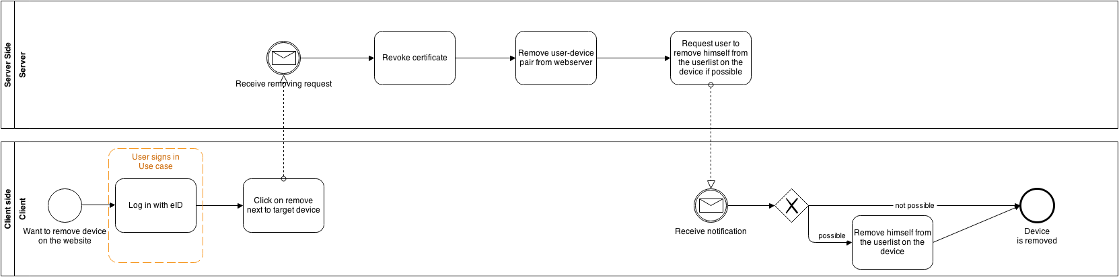
Process P2.1: Remove pair: remove device (on website)

Slide 16
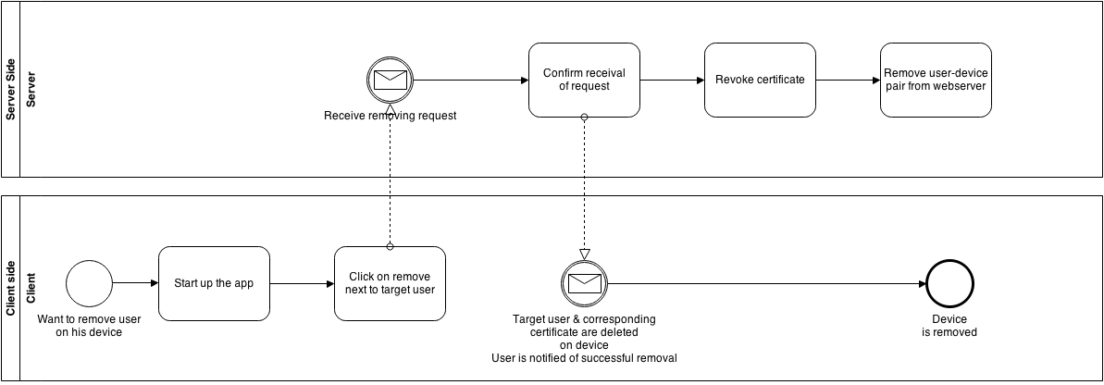
Process P2.2: Remove pair: remove user (on app)

Slide 17
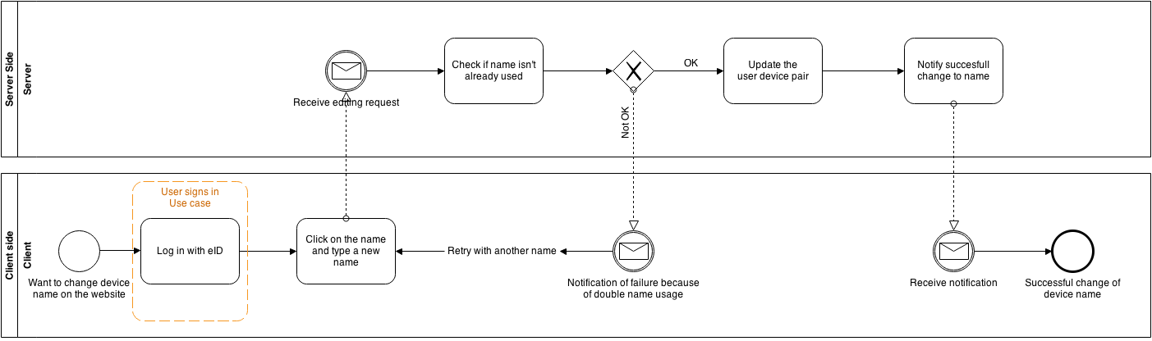
Process P3: Change device name

Slide 18
General Remarks

